Slide 1





FYP Final Presentation
Mas Khairul Amir (214199Y)
Ryan (210731E)

Slide 2
Table of contents
01
02
03
04
05
06
Objectives
Features
Allocated Tasks
Challenges
Demo
Q&A

Slide 3

01
Objectives

Slide 4
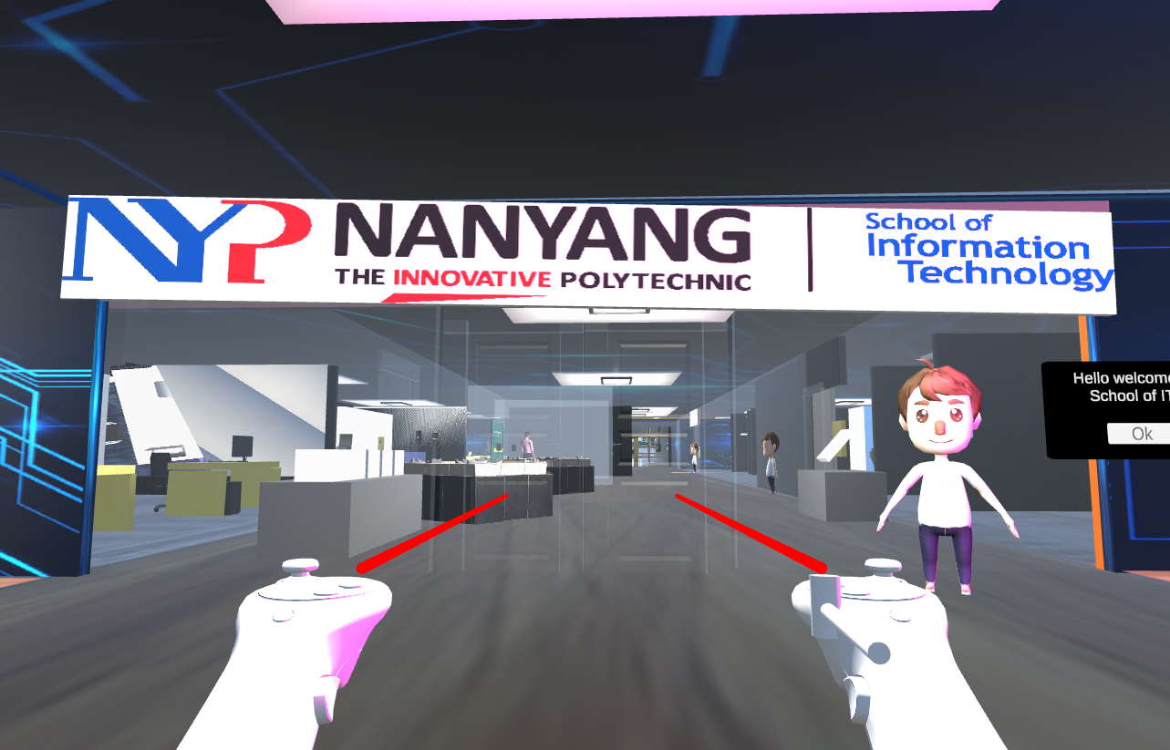
Objectives
Create a metaverse for Centre for IT Innovation(CITI) - CITI Land
Create a fun and interactive experience
Users able to explore and try different features while using the Oculus Headset

Slide 5
02
Features

Slide 6
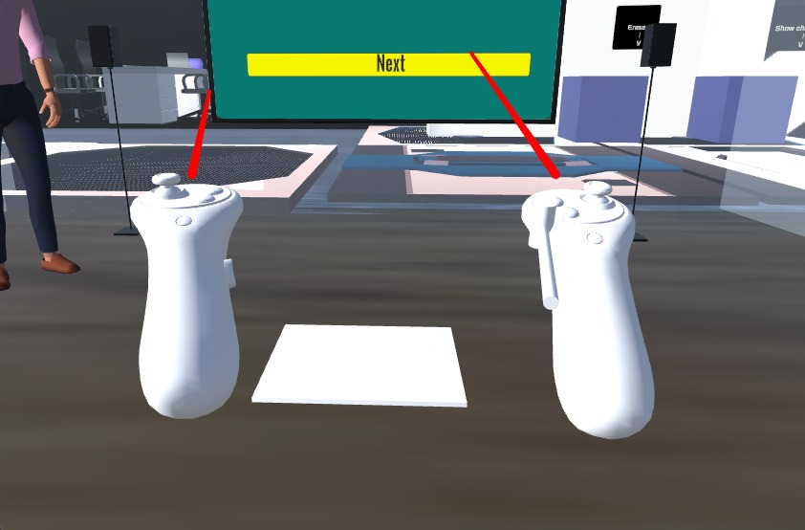
Main Features (Presentation Room)
Audio Trigger Tile

Slide 7
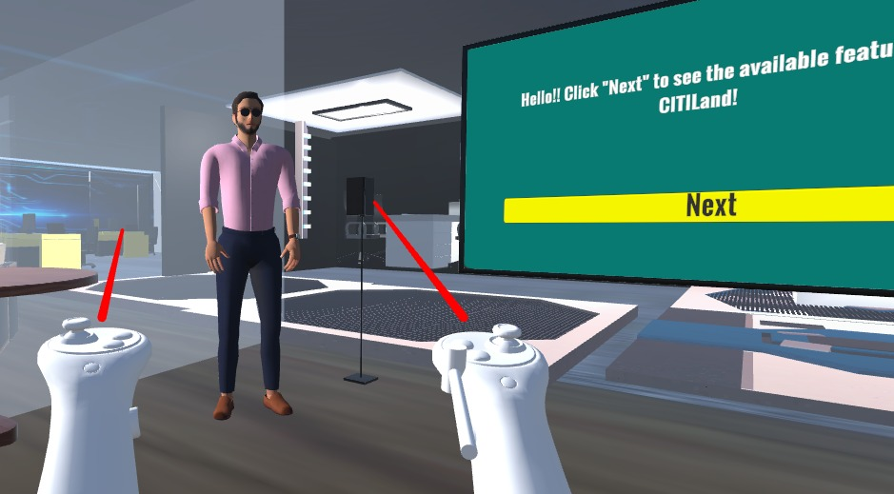
Main Features (Presentation Room)
Non-Player Character (NPC) as Presenter/Speaker
Click for audio

Slide 8
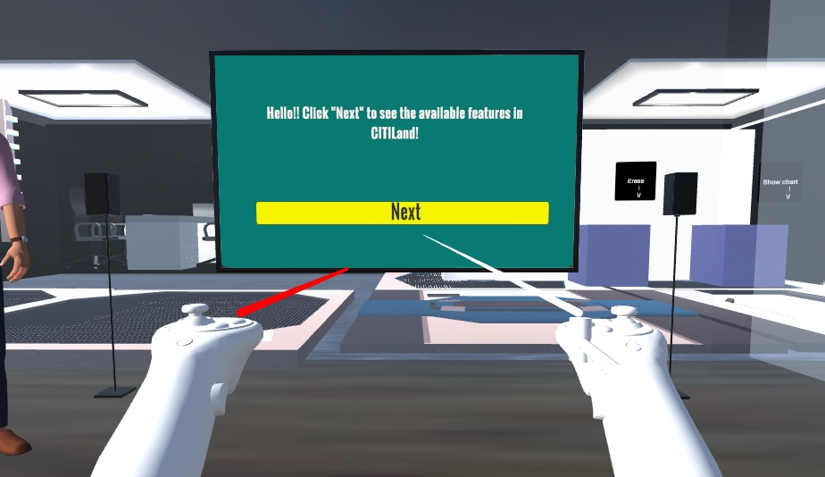
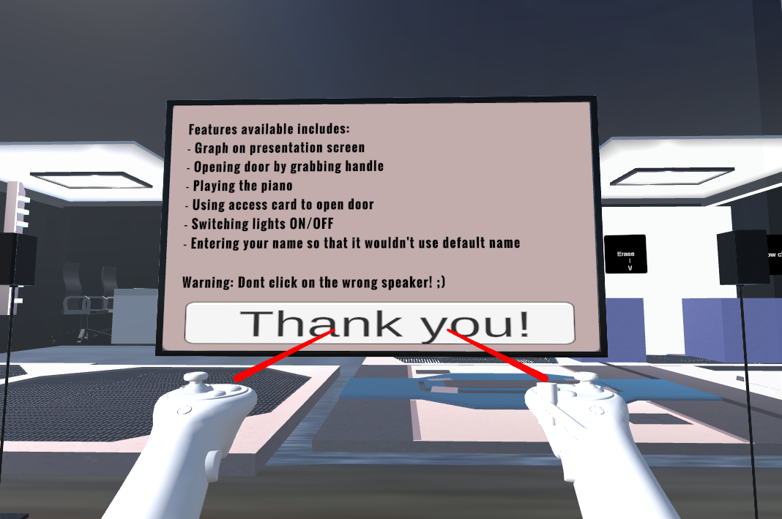
Main Features (Presentation Room)
Interactive presentation screen

Slide 9
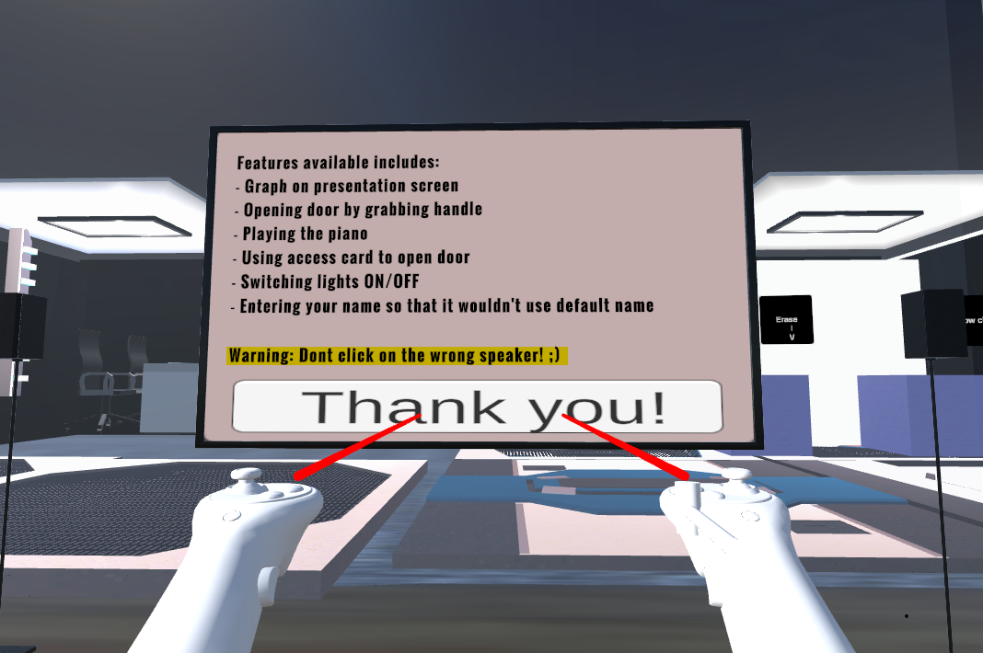
Main Features (Presentation Room)
Hidden Features
Inject humour
Create a memorable and more enjoyable experience for users
Showcase possibilities of Unity
Increase user interaction (Have to click on character to make it disappear)

Slide 10
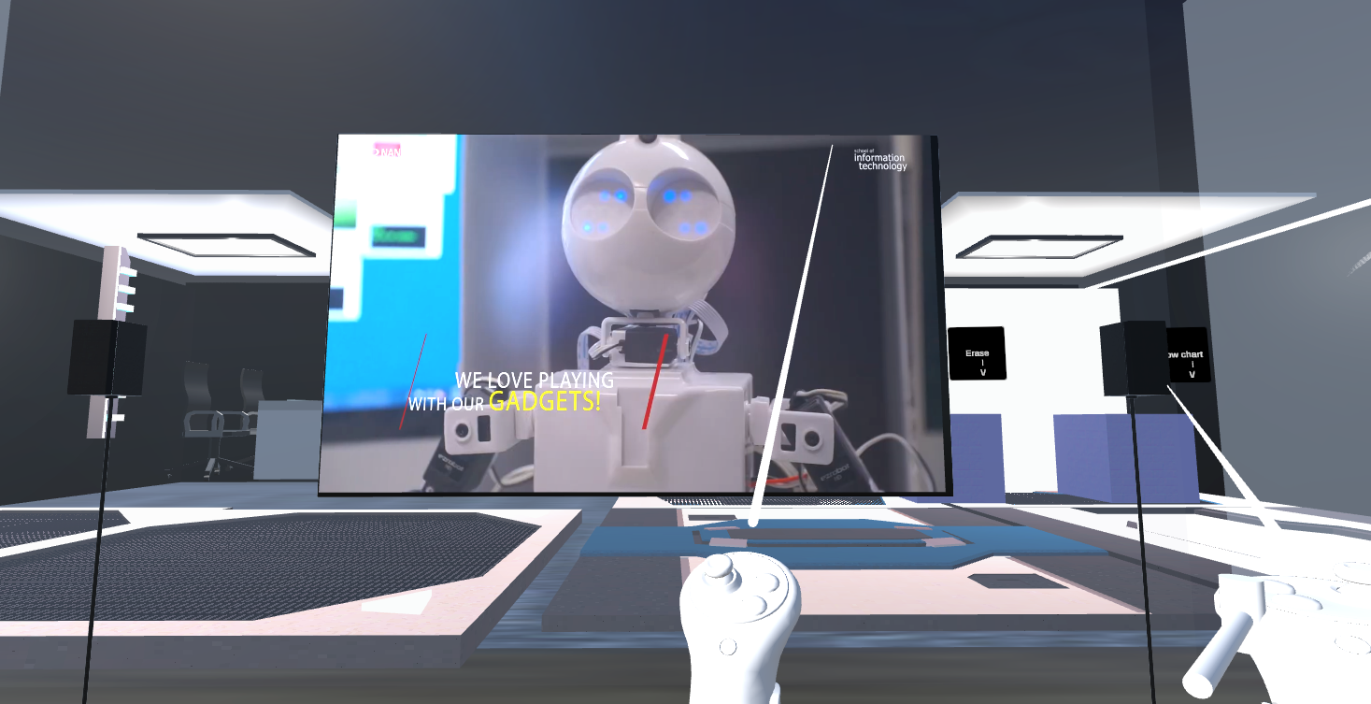
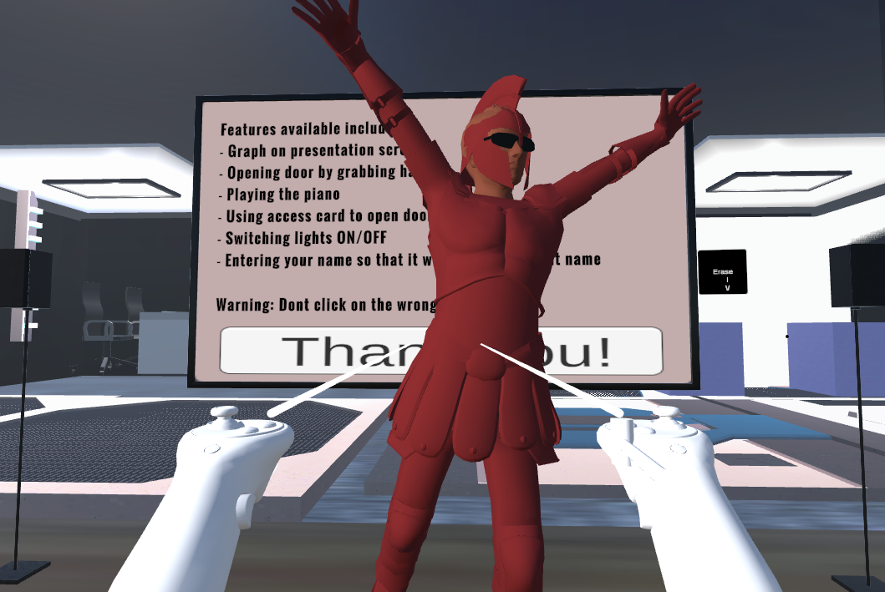
Main Features (Presentation Room)

Slide 11
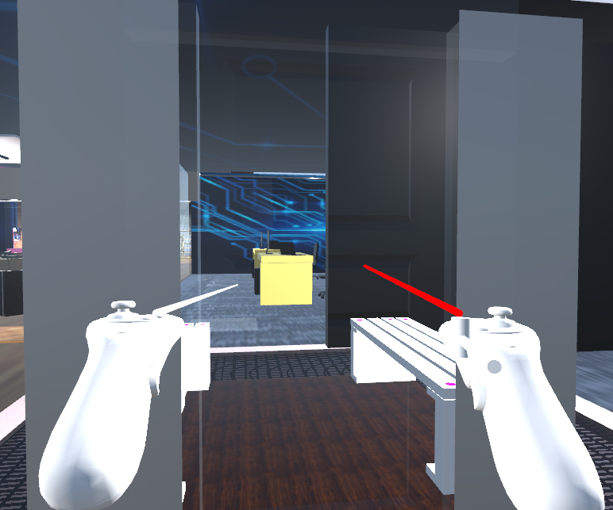
Main Features ( Study Pod )
Closed door which has an interactive handle

Slide 12
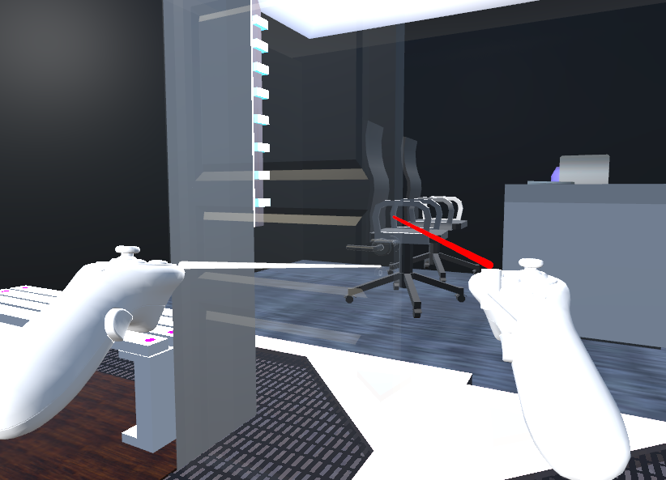
Main Features ( Study Pod )
Upon clicking on handle, door can be swung open

Slide 13
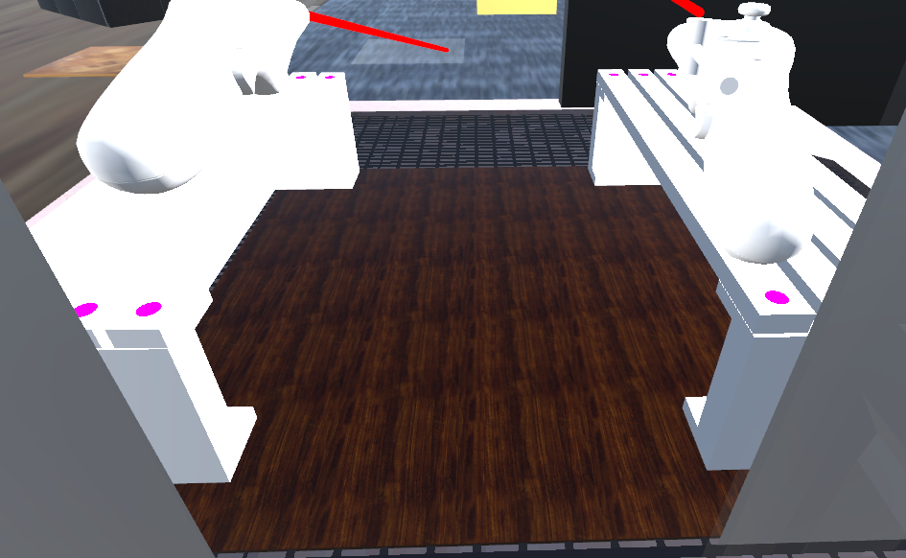
Main Features ( Study Pod )
Audio Trigger Floor where music can be played upon standing on it

Slide 14
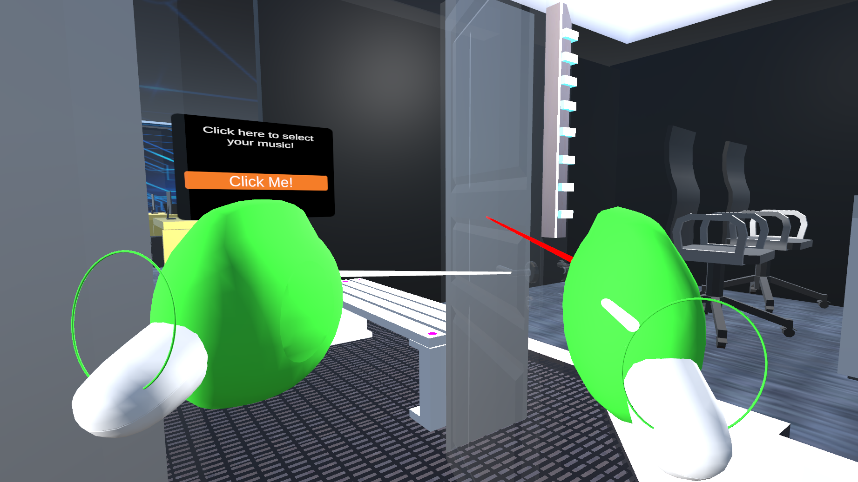
Main Features (Study Pod)
Interactive door handle

Slide 15
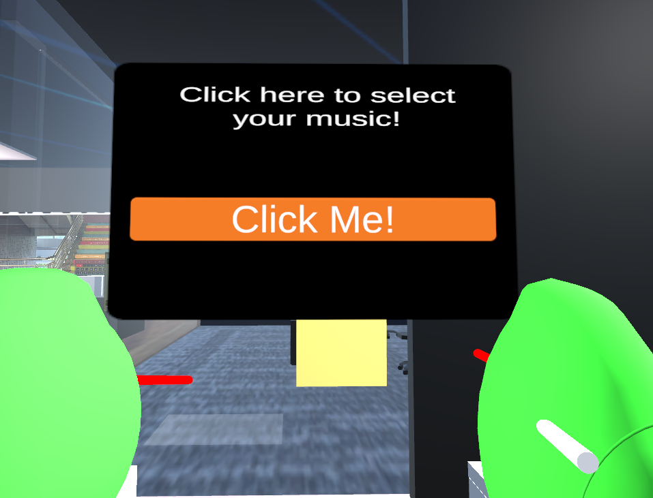
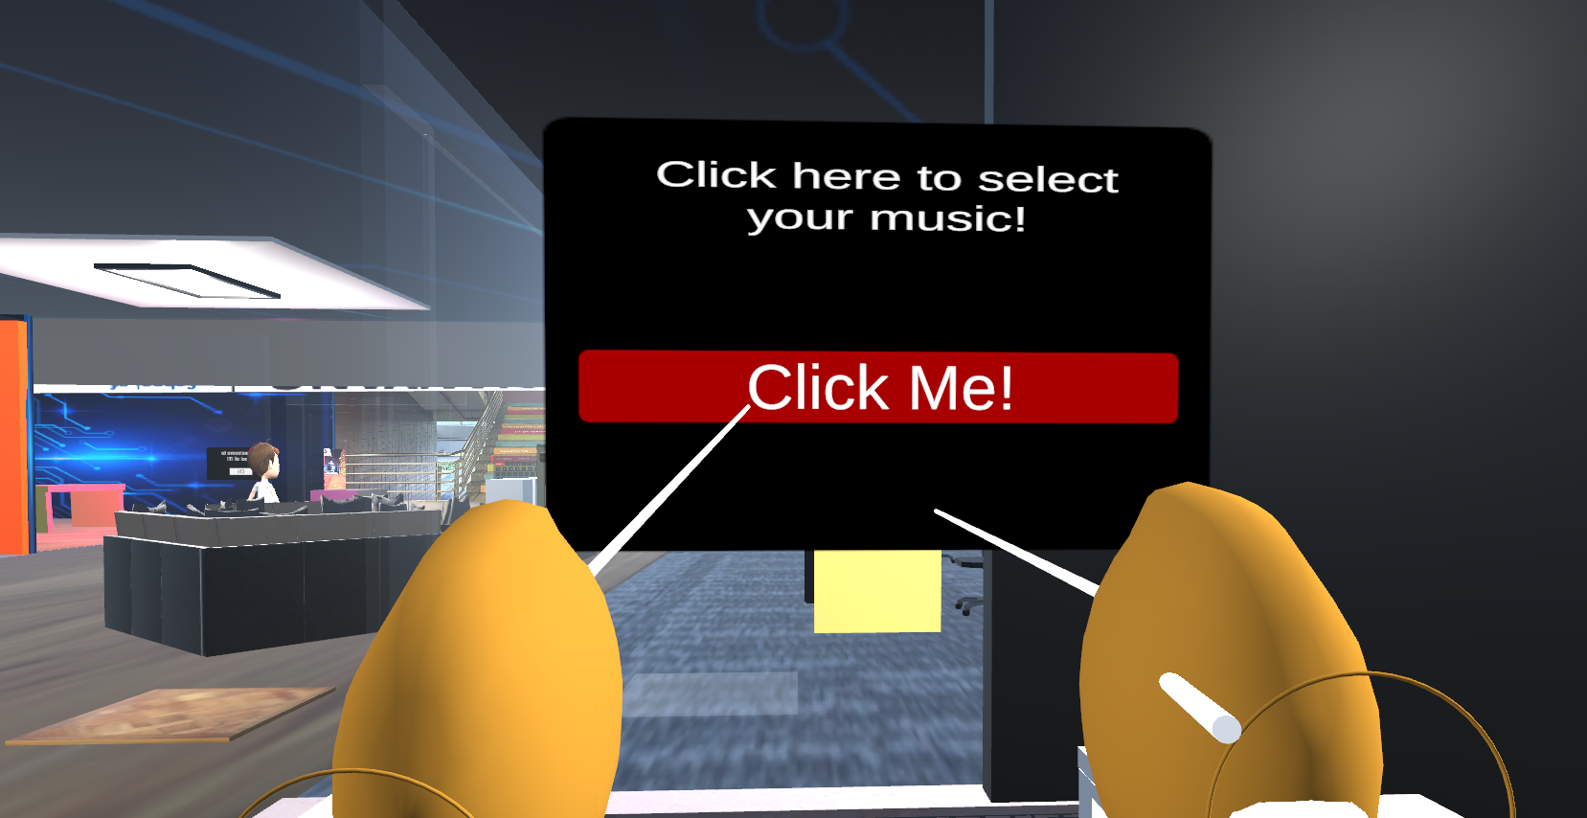
Main Features (Study Pod)
Interactive UI Panel and button

Slide 16
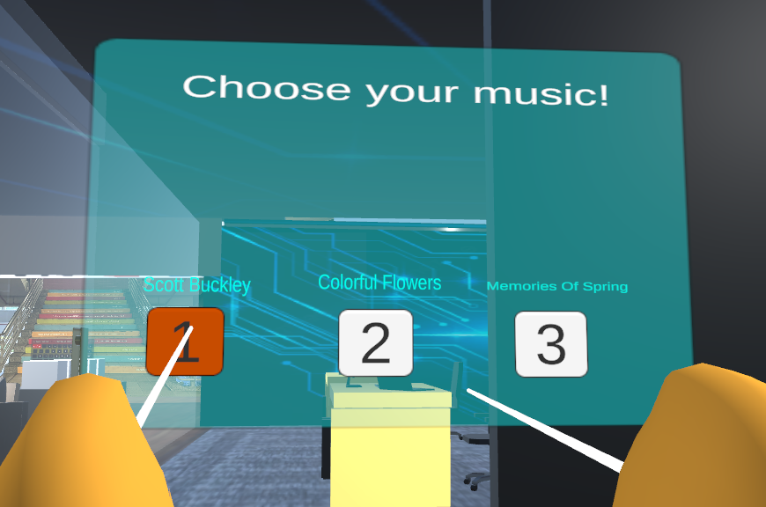
Main Features (Study Pod)
Interactive Button Hidden Features
Upon selection, a different music will be played
Background audio will be paused
Re-click for music to stop, background audio will resume.
Able to select other options once stopping previous option selected.

Slide 17
03
Allocated Tasks

Slide 18
Week 1-6 (Presentation Room)
Explore asset store
Added a TV Screen, 2 Speakers
Tried different NPCs
Research on Text-to-speech
Different ways of adding audio (different audio triggers functions)
Implement audio into NPC (click using Mouse)
Implement collider on Tile (tried different ways to trigger audio)
Trigger when player collides with the layer the tile is on

Slide 19
Week 7-12 (Presentation Room)
Week 7-10
Research on ways to stop the audio of NPC
Able to achieve function using mouse click
Research and try to implement Google Text-To-Speech API to Unity
Able to implement but function couldn’t work due to server issue
Took too long to implement
Week 10-12
Research on interesting features to add on to CITI Land
Implement hidden features (jumpscare, video screen)
Able to achieve function using mouse click
Implement all features so that it would work on Oculus

Slide 20
Week 1-6 (Study Pod)
Exploring features of unity hub and unity asset stores
Create a study pod with different methods like blender, probuilder etc
Made a door with an interactive handle to handle opening and closing
Tested multiple benches to find most suited
Research on Audio Source for play
Create a floor where music can be played once stepped upon and stopped once stepped off
Research on Sit Function for bench
Create a sit controller for bench so players can interact with a keybind to sit

Slide 21
Week 7-12 (Study Pod)
Week 7-10
Research on ways to create an interactive UI Panel
Able to create the first panel with an interactive button
Research on ways to do an onClick function and GameObject.SetActive for the button
Able to make the first page disappear and display the second page
Week 10-12
Researched on how to make the audio source play upon selection of option
Able to create button to play selected audio and pause background audio, along with reclicking to pause the audio and resume background audio.
Responsive buttons also change colors upon clicking

Slide 22
04
Challenges

Slide 23
Presentation Room
Challenges
Solutions
Insufficient examples of Google Text To Speech API
Took me awhile to make functions work on Oculus Headset
Vision was blurry when using Headset
Communication
Come up with other features so that time is not wasted on one feature
A lot of research and discovered XR Simple Interactable Package
Take short breaks once in awhile before working on features in Oculus Headset

Slide 24
Study Pod
Challenges
Not enough examples around to explain how to create different panels and make them disappear while making the other appear.
Took me some time to redo everything from scratch for features i wanted to create
Had to finish everything within 2 weeks since it was a last minute change.
Solutions
Did everything i could to come up with within the 2 weeks, such as creating the active game object, creating responsive UI Buttons
UI Buttons change upon clicking or hovering on them.

Slide 25
05
Demo

Slide 26
06
Thank you!
Any Questions?

